Slide 1

Module 1
The Method of Least Squares
Matrix Formulation of Regression
Notes:
Guidelines
Use section headers to chunk content in your presentation.
Use the same style of section header throughout your presentation.
Keep your title to no more than 2 lines.

Slide 2
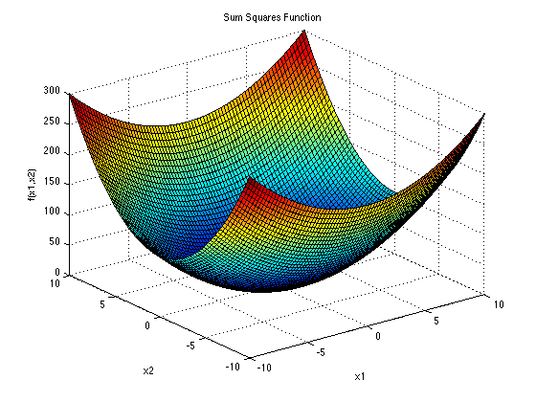
The Least-Squares Method
Notes:
Guidelines
Use a title slide at the beginning of your presentation. There are 9 variations of title slides to choose from.
If you will have a series of slideshows, we recommend using the same style of title slide for each presentation.
Keep your title to no more than 2 lines.
Do not change the font style or font size of the title or subtitle.

Slide 3
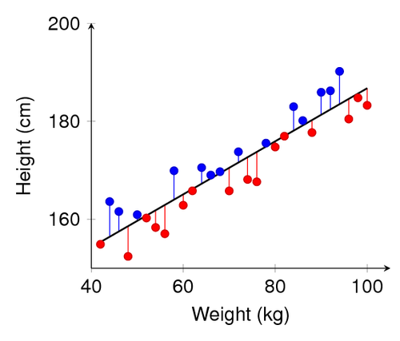
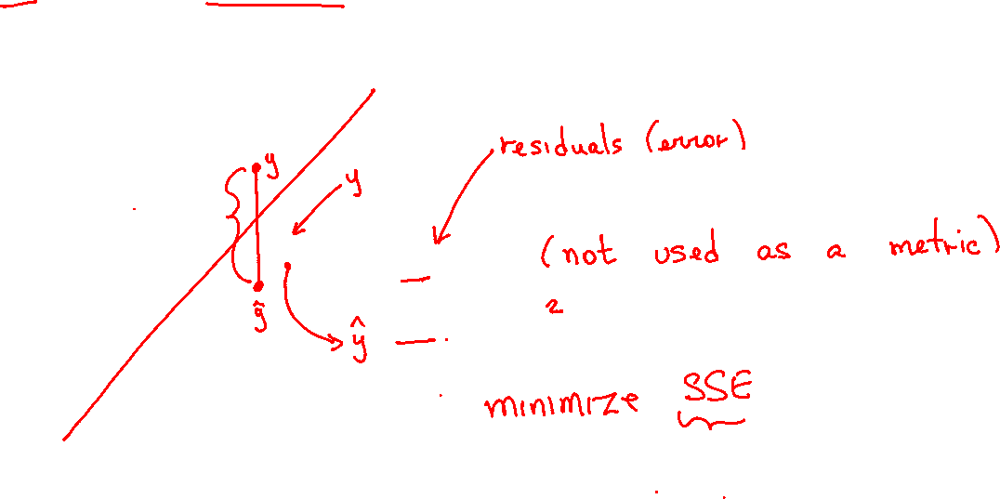



Sum of Squares Error
The distance from each actual value to the regression line is called the residual: $e_{i}=y_{i}−{\hat{y}}_{i}$
$∑e_{i}$= 0
$$SSE= ∑e_{i}$$

Slide 4
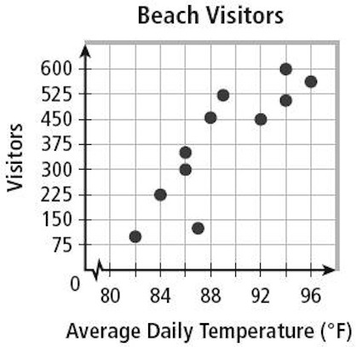


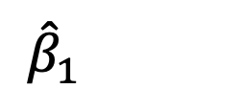

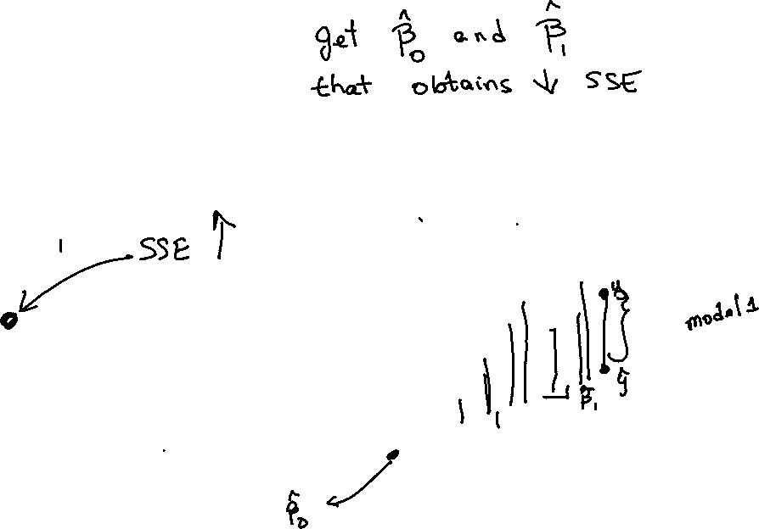
Sum of Squares Error
The sum of squared errors is an important metric in regression
SSE will depend on the choices of ${\hat{β}}_{0}$ and ${\hat{β}}_{1}$
$$SSE$$
${\hat{β}}_{0}$
${\hat{β}}_{1}$

Slide 5
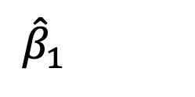
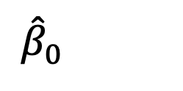
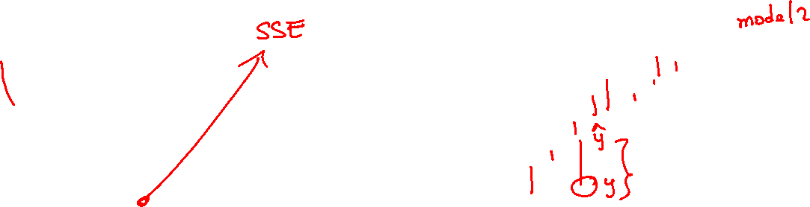
Sum of Squares Error
The sum of squared errors is an important metric in regression
SSE will depend on the choices of ${\hat{β}}_{0}$ and ${\hat{β}}_{1}$
$$SSE$$
${\hat{β}}_{0}$
${\hat{β}}_{1}$

Slide 6

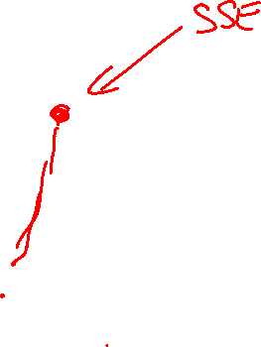
The Least-Squares Method
Involves choosing ${\hat{β}}_{0}$ and ${\hat{β}}_{1}$such that SSE is a minimum
$$SSE$$
${\hat{β}}_{0}$
${\hat{β}}_{1}$

Slide 7

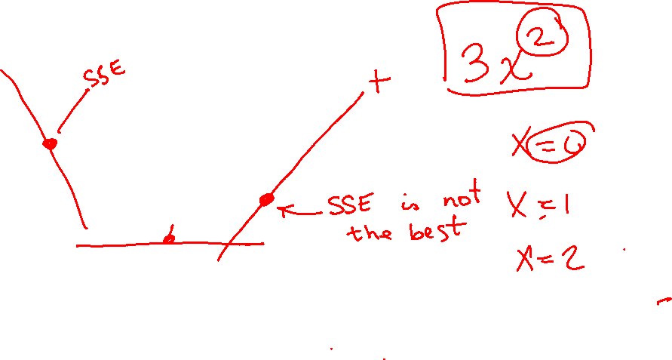
How Are ${\hat{β}}_{0}$ and ${\hat{β}}_{1}$ calculated?
We can use math to derive the minimum of SSE
$$SSE$$
${\hat{β}}_{0}$
${\hat{β}}_{1}$

Slide 8
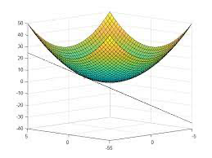

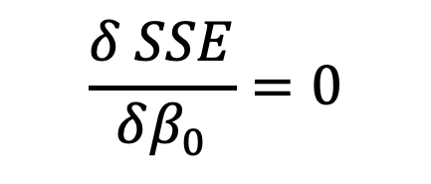
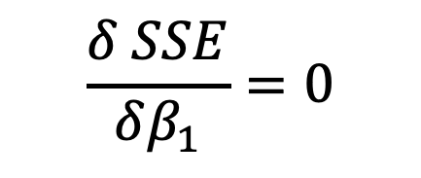
How Are ${\hat{β}}_{0}$ and ${\hat{β}}_{1}$ calculated?
We can use math to derive the minimum of SSE
$$\frac{δ SSE}{δβ_{1}}=0$$
$$\frac{δ SSE}{δβ_{0}}=0$$

Slide 9
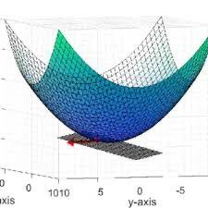

How Are ${\hat{β}}_{0}$ and ${\hat{β}}_{1}$ calculated?
We can use math to derive the minimum of SSE
$$\frac{δ SSE}{δβ_{1}}=0$$
$$\frac{δ SSE}{δβ_{0}}=0$$

Slide 10

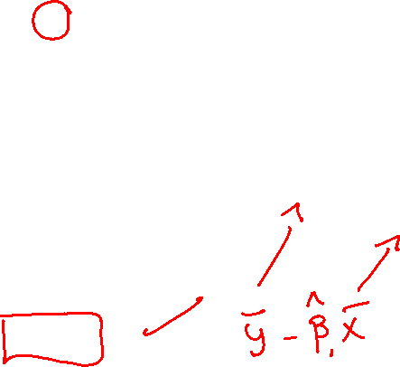
How Are ${\hat{β}}_{0}$ and ${\hat{β}}_{1}$ calculated?
We can use math to derive the minimum of SSE
$$\frac{δ SSE}{δβ_{0}}=0$$
$$\frac{δ ∑{\left(y_{i}−β_{o}−β_{1}x\right)}^{2}}{δβ_{0}}=0$$
$$\frac{δ {\left(∑y_{i}−{nβ}_{o}−β_{1}∑x\right)}^{2}}{δβ_{0}}=0$$
$$2n(∑y_{i}−{nβ}_{o}−β_{1}∑x)=0$$
$${\hat{β}}_{0}=\overline{y}−{\hat{β}}_{1}\overline{x}$$
$$SSE$$
${\hat{β}}_{0}$
${\hat{β}}_{1}$

Slide 11

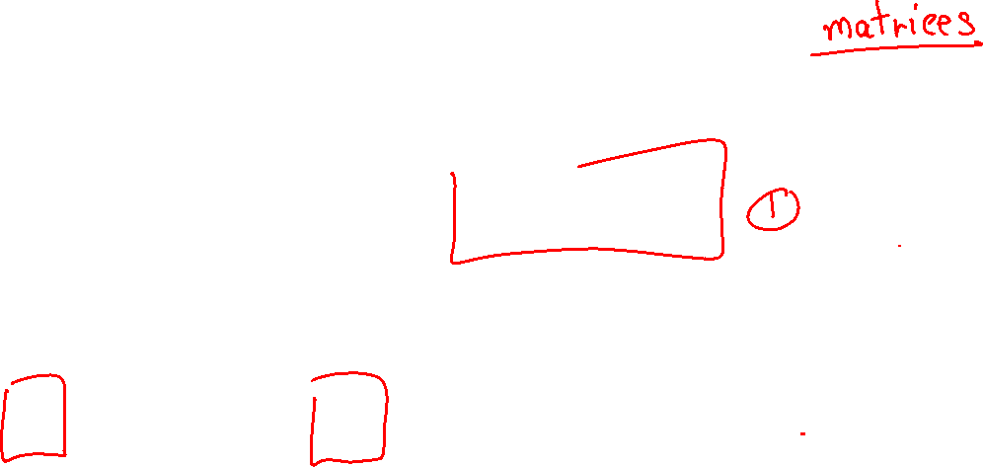
How Are ${\hat{β}}_{0}$ and ${\hat{β}}_{1}$ calculated?
We can use math to derive the minimum of SSE
$$\frac{δ SSE}{δβ_{1}}=0$$
$${\hat{β}}_{1}=\frac{∑(x − \overline{x})(y−\overline{y})}{∑{\left(x − \overline{x}\right)}^{2}}$$
$$SSE$$
${\hat{β}}_{0}$
${\hat{β}}_{1}$

Slide 12

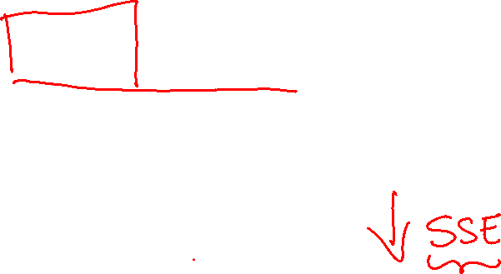
The Least-Squares Method
Goal: Obtain ${\hat{β}}_{0}$ and ${\hat{β}}_{1}$ such that SSE is a minimum

Slide 13
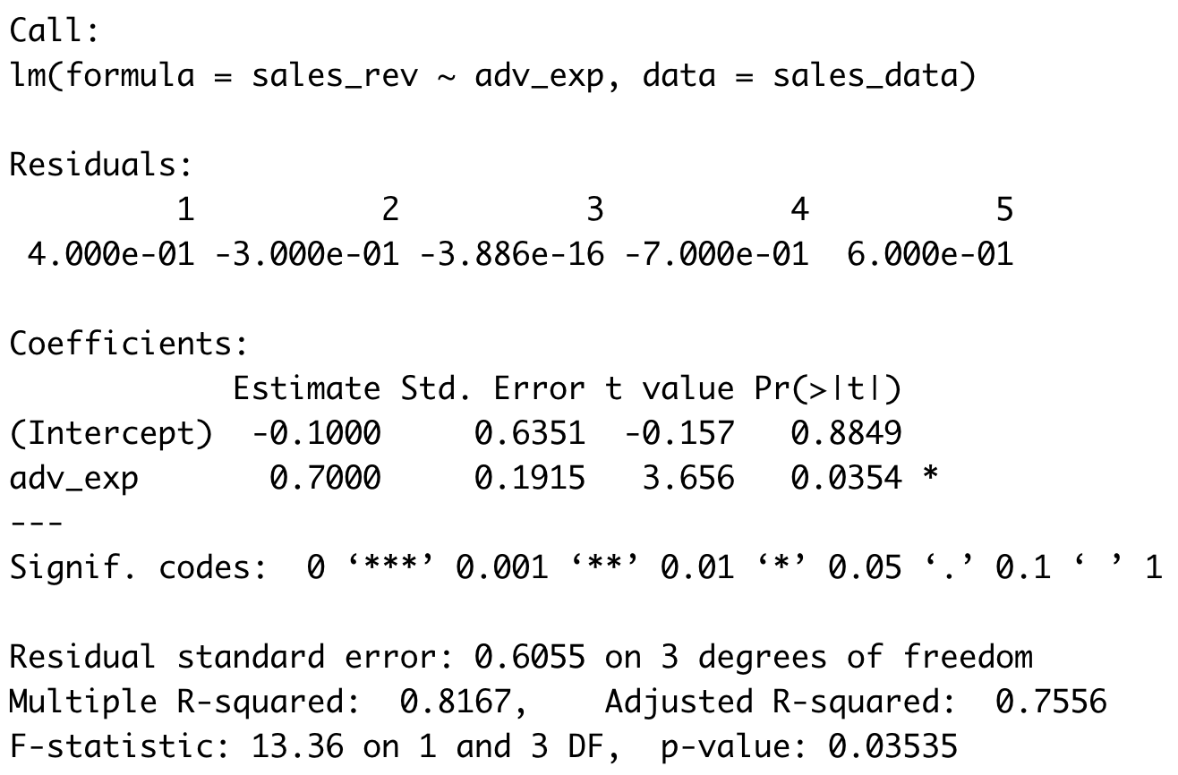



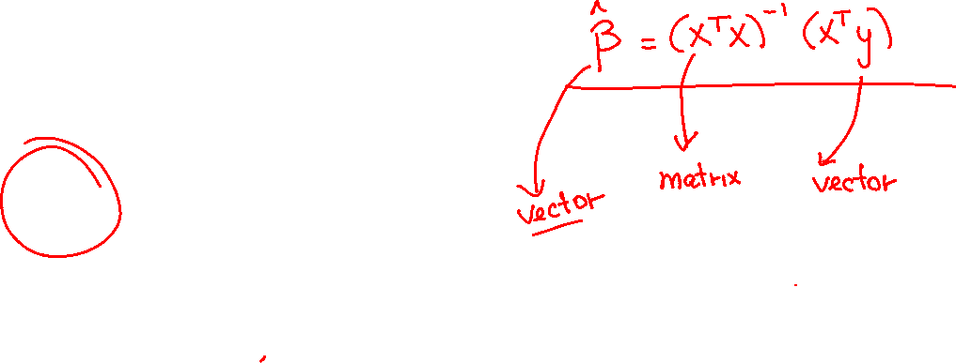
(Least-Squares) Estimates
The summary()function shows the estimates
$${\hat{β}}_{0}$$
$${\hat{β}}_{1}$$

Slide 14
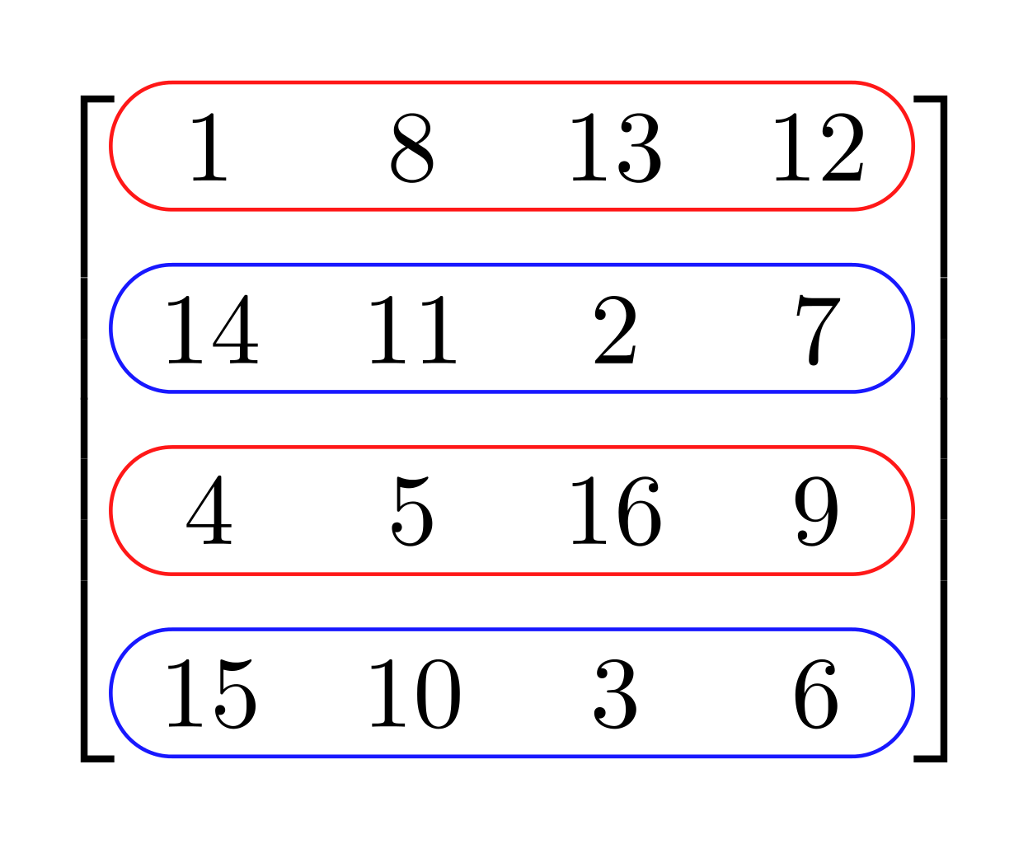
Regression Matrix Formulation
Notes:
Guidelines
Use a title slide at the beginning of your presentation. There are 9 variations of title slides to choose from.
If you will have a series of slideshows, we recommend using the same style of title slide for each presentation.
Keep your title to no more than 2 lines.
Do not change the font style or font size of the title or subtitle.

Slide 15
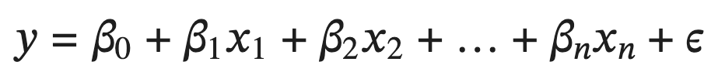

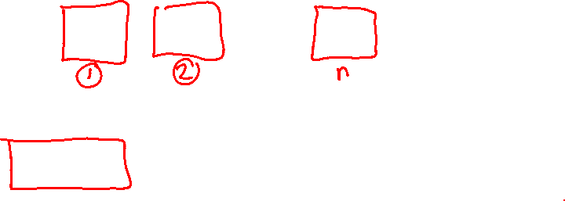
Why a Matrix Formulation?
For multiple variables, the LR model is:
We need a compact notation and formulas to solve for estimates.

Slide 16
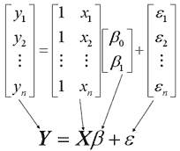

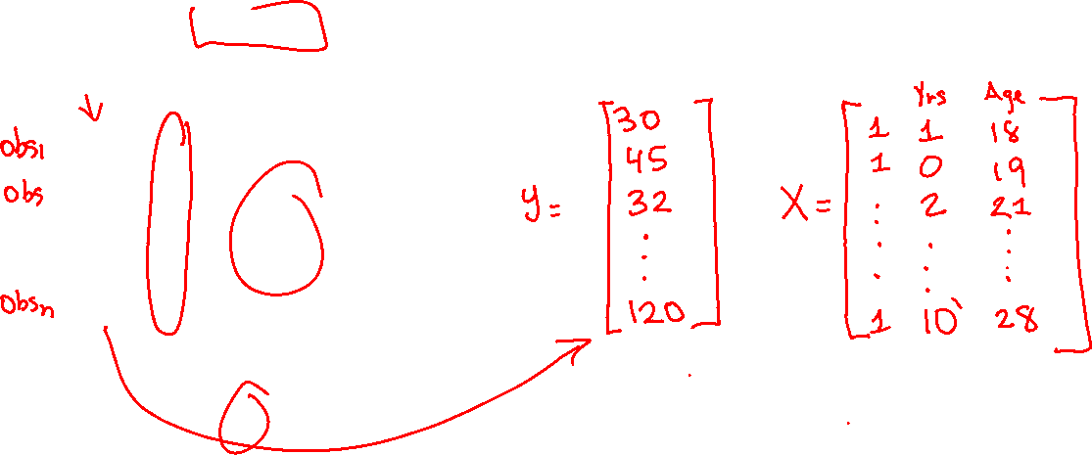
Matrix Formulation of Regression
Using matrices and vectors the model is more compact
Allows for the calculation of all estimates simultaneously.

Slide 17
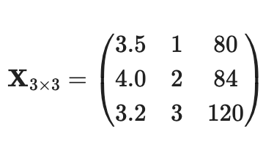
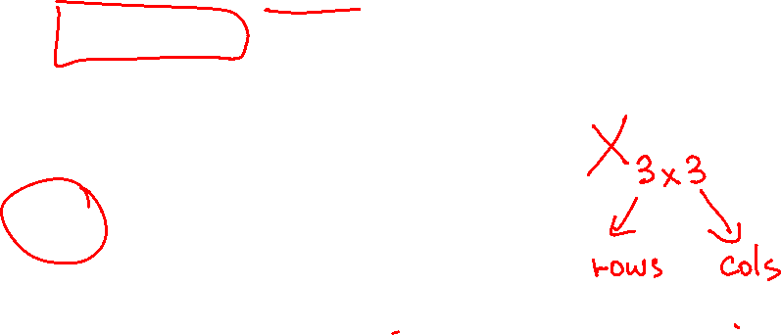
Matrices
Rectangular arrays of numbers (called elements)
Dimensions represents the number of rows and columns in array
X has dimension 3 x 3 (3 rows by 3 columns)
Columns
R
O
W
S

Slide 18
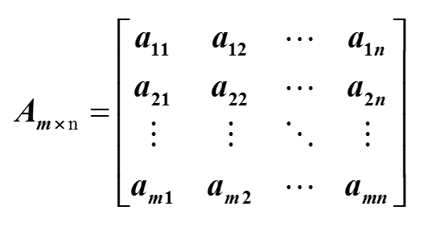

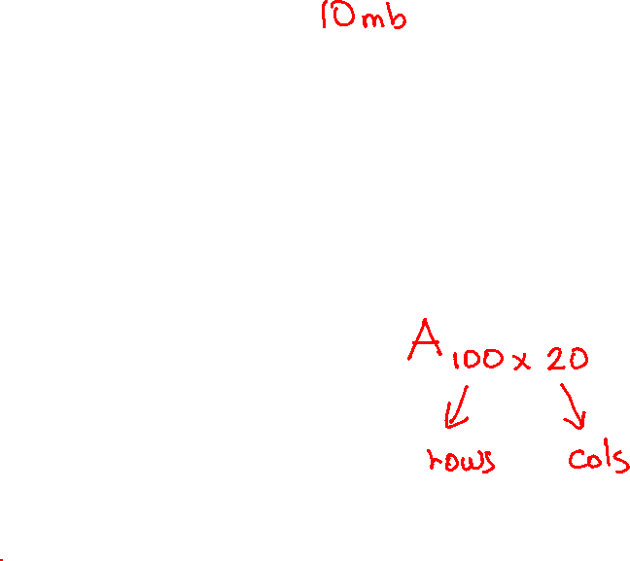
Matrix Dimensions
The matrix below is a generic matrix of size $m×n$
a_{ij} = the number in the i^{th} row and the j^{th} column

Slide 19

Practice

Slide 20
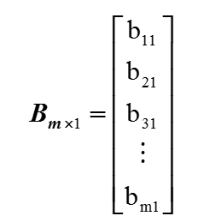


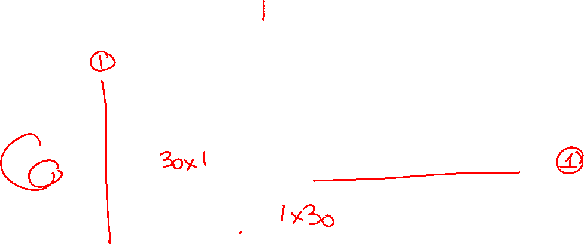
Vectors
A matrix with 1 column ($m×1$) is called a column vector
A matrix with 1 row ($1×m$) is called a row vector

Slide 21
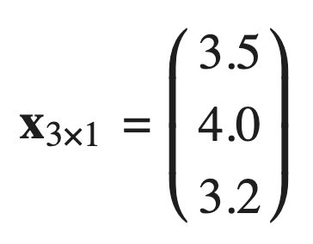

Vectors
A matrix with 1 column ($m×1$) is called a column vector
A matrix with 1 row ($1×m$) is called a row vector

Slide 22
Practice

Slide 23
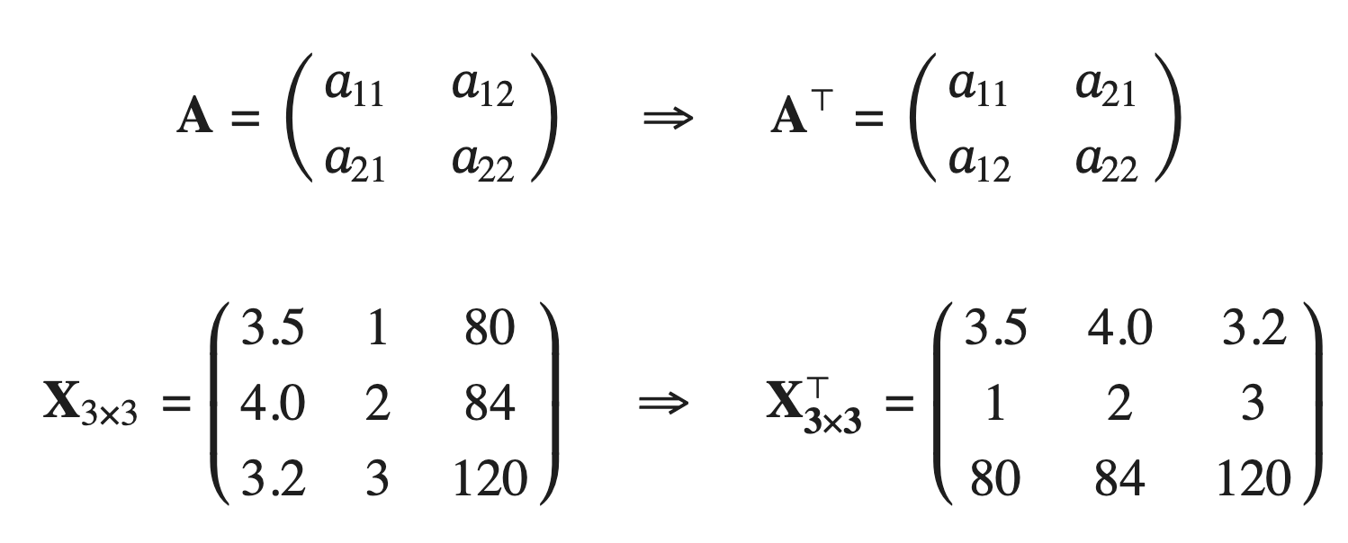
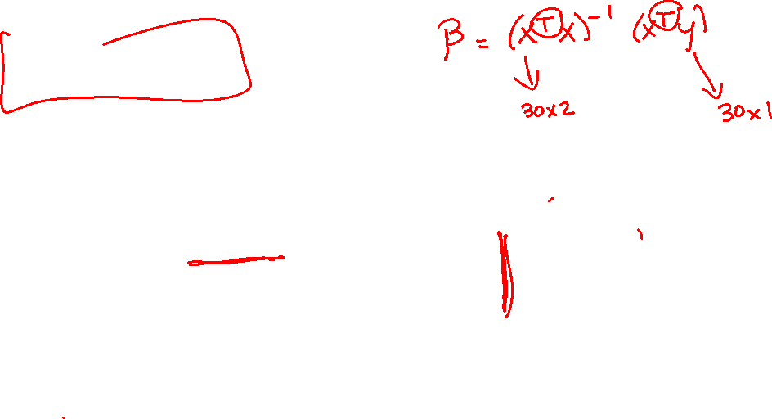
Transpose
Interchanges the rows by the columns

Slide 24
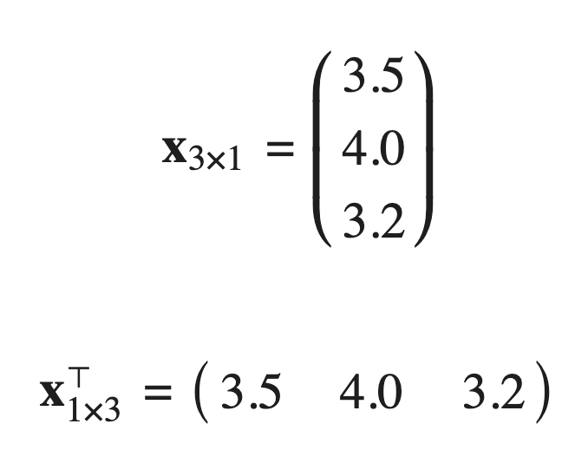
Transpose
Interchanges the rows by the columns

Slide 25
Practice

Slide 26
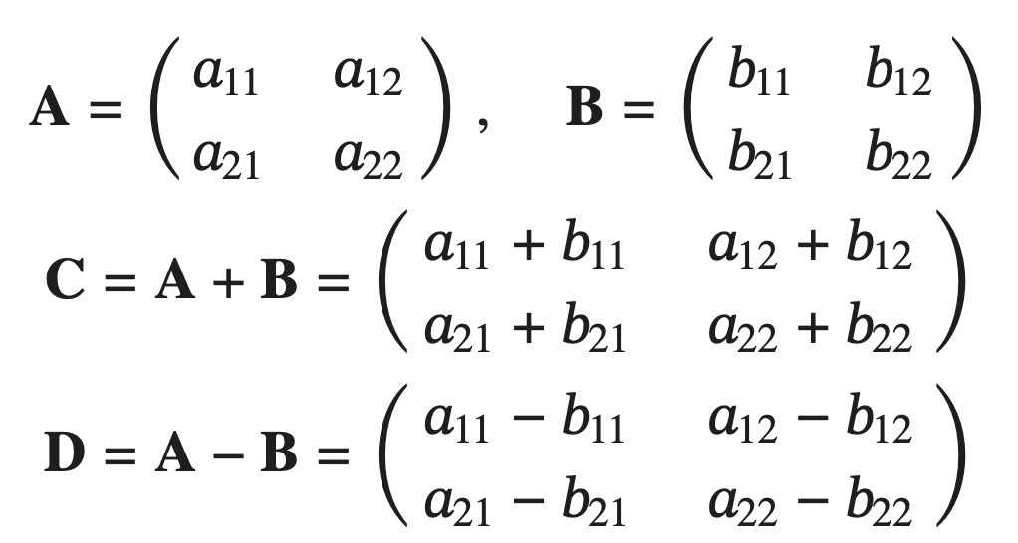
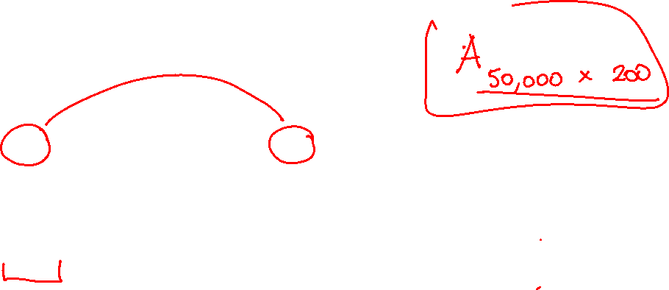
Matrix addition/subtraction
Must be same dimensions

Slide 27
Practice

Slide 28
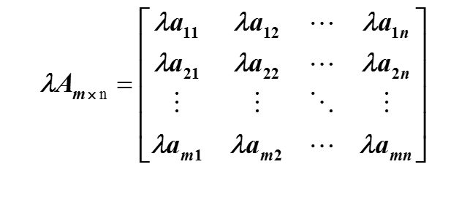
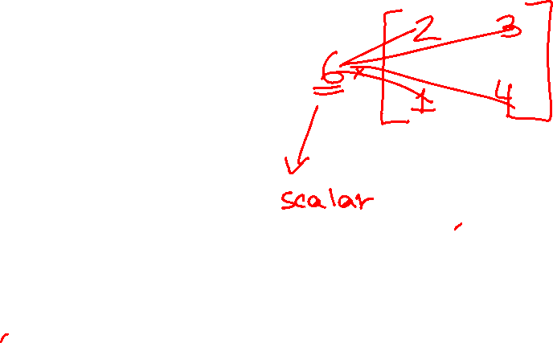
Scalar Matrix Multiplication
Multiply each element by scalar

Slide 29
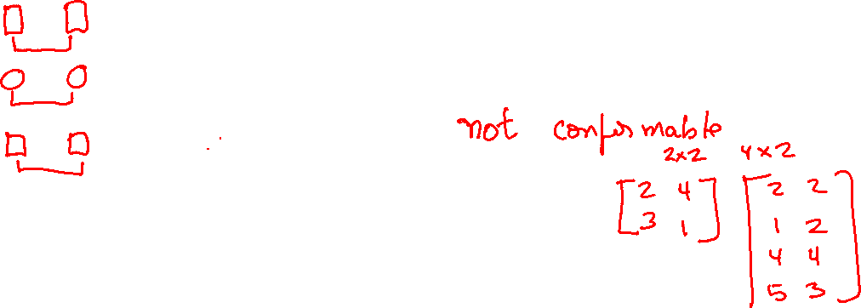
Multiplying a Two Matrices (A and B)
Columns of A must equal rows of B
Resulting matrix is of dimensions rows of A, cols of B
A₂ _{x} ₃ * B ₃ _{x} ₂ can be calculated. Result is C ₂ _{x} ₂
A₃ _{x} ₃ * B ₃ _{x} ₂ can be calculated. Result is C ₃ _{x} ₂
A₃ _{x} ₂ * B ₄ _{x} ₂ cannot be calculated.
A₃ _{x} ₂ * B ₂ _{x} ₇ can be calculated. Result is C ₃ _{x} ₇
A₁ _{x} ₂ * B ₂ _{x} ₁₂ can be calculated. Result is C ₁ _{x} ₁₂

Slide 30
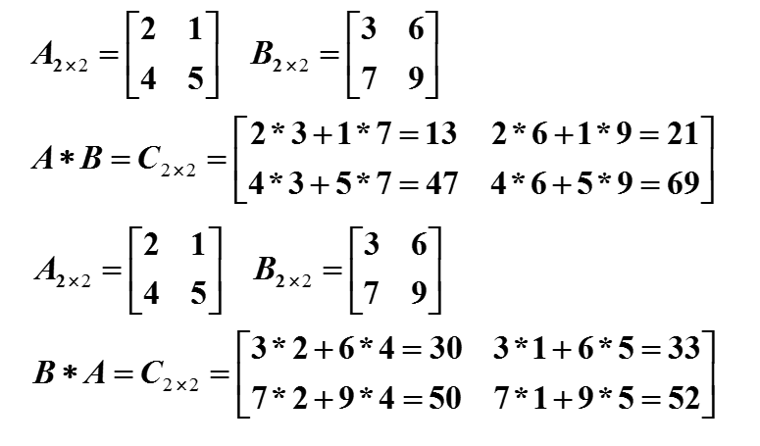
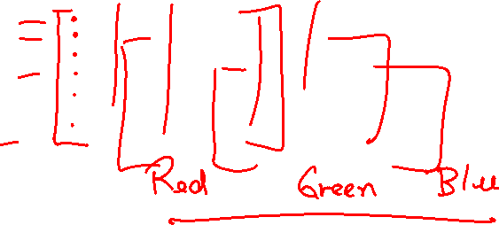
Multiplying a Two Matrices (A and B)
Example

Slide 31
Practice

Slide 32


Linear Independence
A matrix is linearly independent if there is no linear combination in it columns (or rows)
The rank is the number of independent columns.
The determinant of a linearly dependent matrix is 0.
Column 3 equals 2 times column 1 + column 2
A is NOT linearly independent
Rank of A is 2

Slide 33
Practice

Slide 34


Inverse of a Matrix
If a matrix is square (rows = cols), the inverse of a matrix A is the matrix A⁻¹ such that AA⁻¹ = A⁻¹A = I.
A⁻¹ only exists if A is independent.

Slide 35
Practice

Slide 36
Matrix Formulation of LR
For multiple variables, the LR model is:
We need a compact notation and formulas to solve for estimates.

Slide 37

Matrix Formulation of Linear Regression
The response variable can be formulated as vector
$$y=\left[\begin{matrix}y_{1} \\ y_{2} \\ ⋮ \\ y_{n}\end{matrix}\right]$$
The independent variables are formulated as a matrix (design matrix)
$$X= \left[\begin{matrix}1 & x_{11} \\ 1 & x_{12} \\ ⋮ & ⋮ \\ 1 & x_{1n}\end{matrix}\right]$$

Slide 38


Matrix Formulation of Linear Regression
The estimates are obtained by:
$$\hat{β}={\left(X^{⊤}X\right)}^{−1}(X^{⊤}y)$$

Slide 39

Matrix Formulation Example (scratch)
Suppose we have the data:

Slide 40
Practice

Slide 41

Matrix Formulation Example (fit)
Instead of creating the X matrix and y vector from scratch, we can retrieve from regression object if needed.

Slide 42
Practice

